Slide 1

Directions
In the chat, please include your name, email, position, and school name.
Something to think about…
How does your role intersect with the Zones of Choice?
.
What questions and concerns might you have regarding the Zones of Choice?
Important Note
This meeting is being recorded.

Slide 2

Zones of Choice Overview
2025-2026
.
September 24, 2025
2

Slide 3
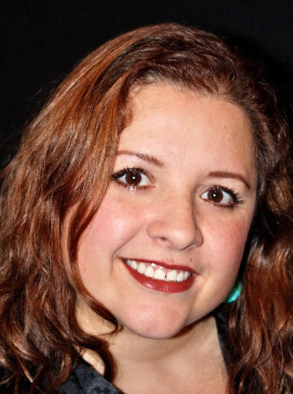
Welcome!
Dunia Fernandez
PPDA
Zones of Choice
Strategic Enrollment & Program Planning Office
dunia.fernandez@lausd.net | (213) 241-0466
3

Slide 4
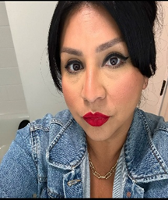


ZOC Facilitators
Angelica Cabrera
ZOC Facilitator
Zones of Choice
Strategic Enrollment & Program Planning Office
amc7753@lausd.net | (213) 241-0461
Rosalinda Vazquez
ZOC Facilitator
Zones of Choice
Strategic Enrollment & Program Planning Office
rosalinda.vazquez@lausd.net | (213) 241-0554
Sabrina Huizar
ZOC Facilitator
Zones of Choice
Strategic Enrollment & Program Planning Office
sabrina.huizar@lausd.net | (213) 241-0589
4

Slide 5
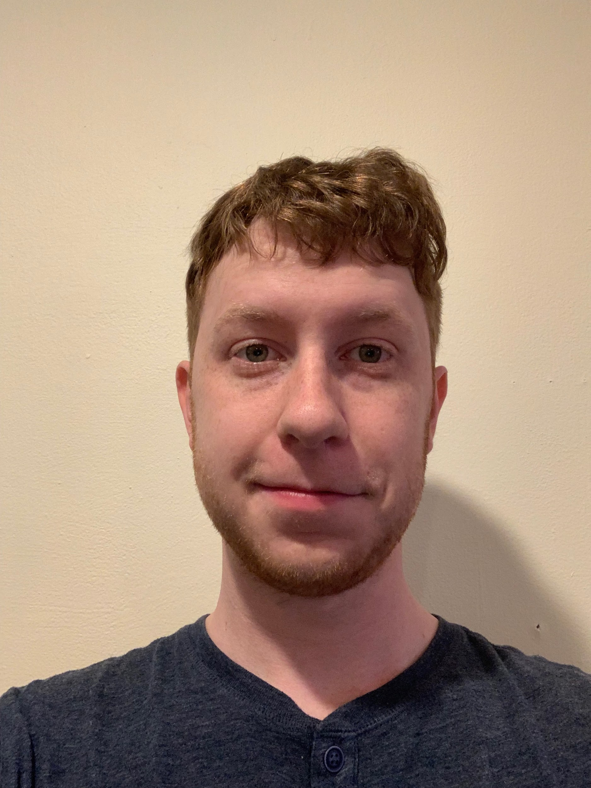
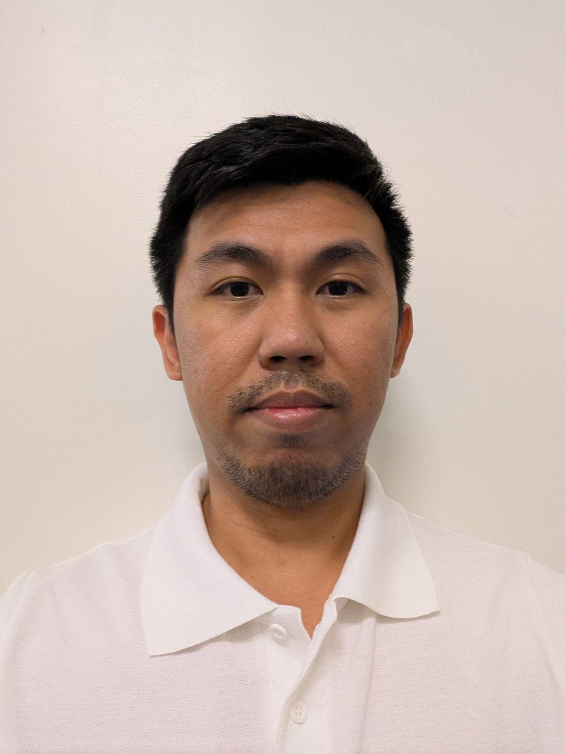
Admin Support
Elias Higham
Administrative Aide
Zones of Choice
Strategic Enrollment & Program Planning Office
elias.higham@lausd.net | (213) 241-1928
Jansen Cheng
Administrative Assistant
Strategic Enrollment & Program Planning Office
jansen.cheng@lausd.net | (213) 241-1125
5

Slide 6
  Introductions
  Background
  Timeline
  Policy and Procedures
  Reference Guides
  Q & A
Agenda
6

Slide 7
Angelica Cabrera
  Belmont ZOC
    Belmont HS, Contreras LC, Cortines VAPA, Roybal LC
  Bernstein ZOC
    Bernstein HS, STEM Academy
  Carson ZOC
    Carson HS STEAM, AEE, AMA
  Huntington Park
    Huntington Park HS, Marquez HS
  Narbonne ZOC
    Narbonne HS, HArts Academy
  Northeast ZOC
    Lincoln HS, Wilson HS
FACILITATOR ASSIGNMENTS
7

Slide 8
Rosalinda Vazquez
  Boyle Heights ZOC
    Mendez HS, Roosevelt HS
  Eastside ZOC
    Garfield HS, Eastside HS, Torres HS Complex
  Fremont ZOC
    Dymally HS, Fremont HS, Rivera LC
  South Gate ZOC
    Legacy HS, South East HS, South Gate HS
  South Gate MS ZOC
    International LC, Southeast MS, South Gate MS
FACILITATOR ASSIGNMENTS
8

Slide 9
Sabrina Huizar
  Bell ZOC
    Bell HS, Elizabeth LC, Legacy HS, Maywood Academy
  Jefferson ZOC
    Angelou CS, Jefferson HS, NAVA College Preparatory Academy, Santee EC
  North Valley ZOC
    Chavez LA, San Fernando HS, Sylmar Charter HS
  Northwest ZOC
    Northridge Academy, Valley Academy of Arts & Sciences
  RFK ZOC
    ASGL, LAHSA, NOW, SVAH, UCLA Community School
  San Fernando Area MS ZOC
    San Fernando MS, San Fernando Institute of Applied Media
FACILITATOR ASSIGNMENTS
9

Slide 10
WHY THE ZONES OF CHOICE?
January 10, 2012: The School Board passes the Resolution on Expanding Enrollment and Equal Access through LAUSD Choice (Expands overall district enrollment at least 5% over three years.)
January 17, 2012: The School Board passes the Resolution to Examine Increasing Choice and Removing Boundaries for Neighborhood Schools. (Examines the potential impact on equity and quality of schools by transitioning to a full choice school system.)
Office of School Choice: Parents have more choices and the ability to easily access their school options.
10

Slide 11
WHAT ARE THE ZONES OF CHOICE?
Geographic areas comprised of multiple school options.
Offer exciting programs in the arts, business, science, humanities, social justice and more right in your neighborhood.
School options include, large campuses, small learning communities, academies, and more.
11

Slide 12
HOW DOES IT WORK?
Students residing in a Zone of Choice are eligible to attend any school in the Zone.
No home school – home zone.
Students select and rank the schools within their residential area.
For SY 2025-2026 there are 17 Zones of Choice with 99 school options.
12

Slide 13
TWO OPTIONS TO APPLY *
Students will complete the application online at their current middle school site (only current 8th graders.) NEW APPLICATION!
Parents can submit an online application from October 1 – November 14, 2025 (current 8th graders, 5th graders in South Gate MS ZOC)
Year-Round Parents can now submit an online application year-round beginning December 1st NEW APPLICATION!
Paper applications accepted as of November 17th
13

Slide 14
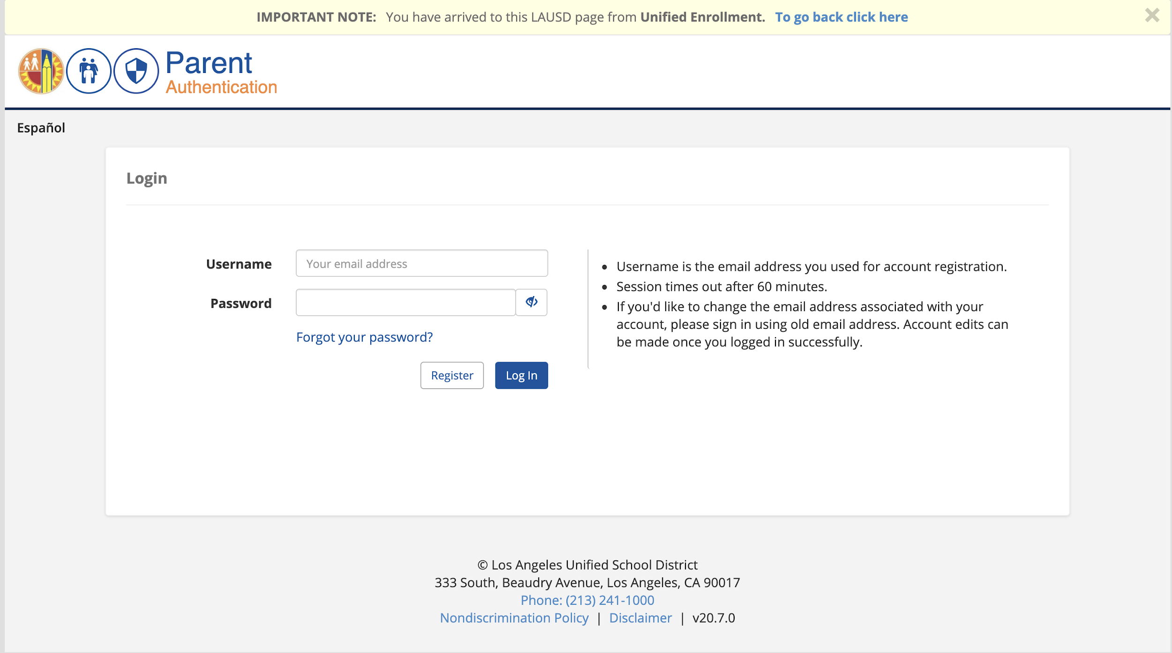
PARENTS: ONLINE APPLICATION
When: October 1 – November 14, 2025
Where: Apply.LAUSD.net
Who: All current and new LAUSD students entering 9th grade and 6th grade
Help: (213) 241-0466
14

Slide 15
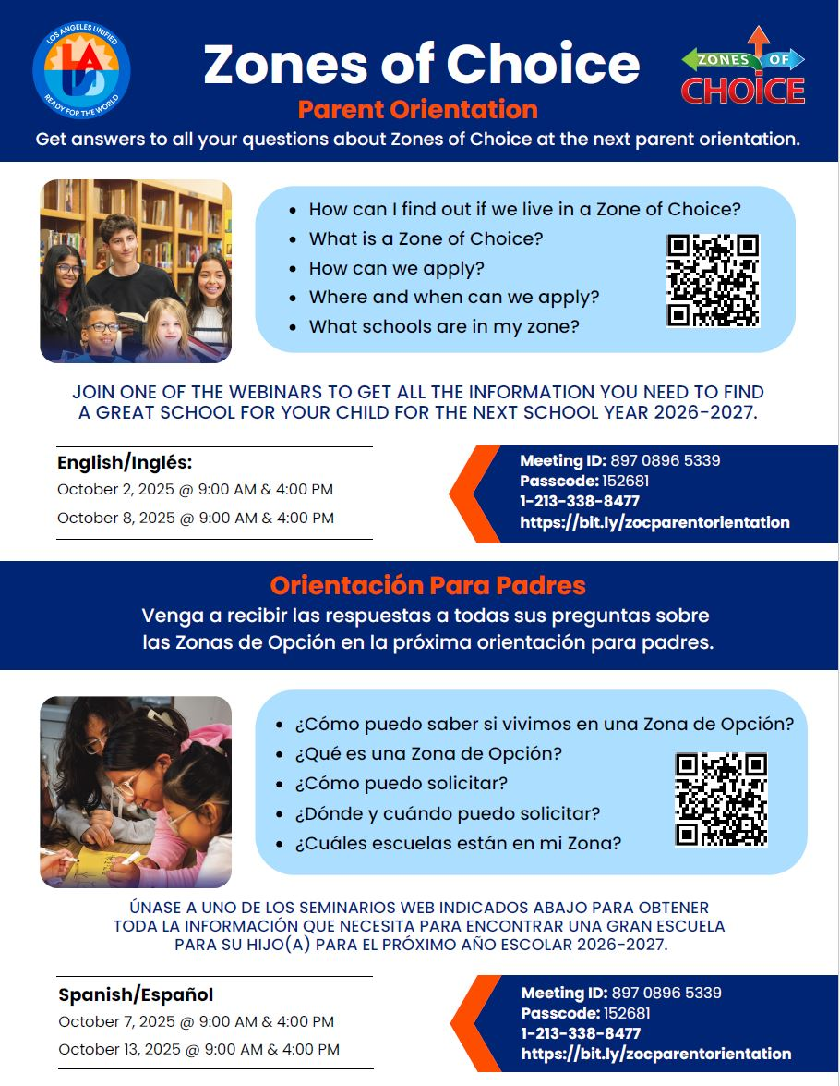
VIRTUAL PARENT ORIENTATIONS
  Tuesday, 10/02/25 @ 9:00 am (ENG)
  Tuesday, 10/02/25 @ 4:00 pm (ENG)
  Tuesday, 10/07/25 @ 9:00 am (SPAN)
  Tuesday, 10/07/25 @ 4:00 pm (SPAN)
  Wednesday, 10/08/25 @ 9:00 am (ENG)
  Wednesday, 10/08/25 @ 4:00 pm (ENG)
  Wednesday, 10/13/25 @ 9:00 am (SPAN)
  Wednesday, 10/13/25 @ 4:00 pm (SPAN)
15

Slide 16
PARENT ORIENTATIONS
Webinar ID and Link:
https://bit.ly/zocparentorientation
Webinar ID: 897 0896 5339
Passcode: 152681
Call: (213) 338-8477, 89708965339#
16

Slide 17
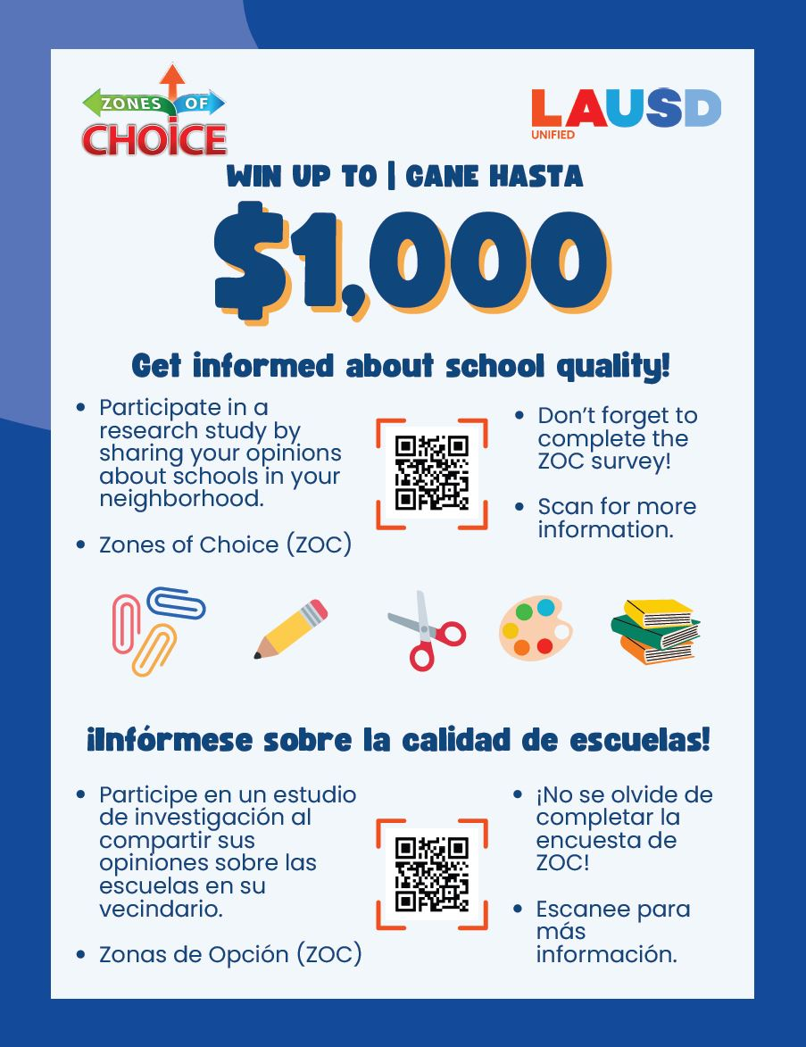

RESEARCH STUDY
University of Chicago & University of Michigan
Only current 8th graders are eligible
Surveys (Text Messages)
Students are eligible to win up to $1,000
Letters that show school level percentile rankings in Achievement Growth and Social Emotional Learning
17

Slide 18

POLICY & PROCEDURES
ZOC School Applications
  Online – Apply.LAUSD.net
  Paper – LAUSD.org/zoc email to zoc@lausd.net NO MORE FAX
  Check residential address
  Do not provide parents information regarding space in your school
  Only enroll students that are on your ZOC student roster, not MISIS
ZOC School Brochure
  Prepare updates and edits
  Submit all changes to ZOC
  Review published version
ZOC School Videos
  Submit new videos or provide instructions if keeping old video online

Slide 19
POLICY & PROCEDURES
Family Outreach
Parent Outreach
  Flyers
  Blackboard Connect calls, text messages, & student emails
  Webinar Parent Orientations (English/Spanish)
Articulation Activities
  Elementary & Middle school invitations should include ALL high schools in the Zone, South Gate MS ZOC, and San Fernando Area MS ZOC
  Provide equal access and time to each school
  Ask ZOC team for coordination support
  Focus on school highlights, not on negative information
Notes:
Please refer to timeline

Slide 20
POLICY & PROCEDURES
Assignments
Current 5th & 8th Graders (6th graders in Montara ES)
  Articulation Lists
  SLC & Grade Breakdown
  Assignments are based on preference and space availability
  ECAST & Operational Capacity
Rounds of Assignments
  Five rounds from March-June
  Lists are cumulative
  Include students accepted into Choices programs (Magnet, SAS, Affiliated Charter School, Dual Language Education, etc.)

Slide 21
POLICY & PROCEDURES
Appeals & OTTs
Appeals
  Parent initiated
  Processed only by ZOC
  Based on hardship
  Accepted beyond application window
  None accepted after Norm Day
One-Time Transfer (OTT)
  Current 6-7th and 9-11th graders
  Schools should provide reasoning for non recommendation
  ZOC office retains discretion for approval/denial
  Student must be in good standing
  Cannot be used for safety concerns (Opportunity Transfer)
  Accepted beyond application window

Slide 22
POLICY & PROCEDURES
Permits
Intra-District Permits and Open Enrollment:
  Open Enrollment Permits/Intra-District Transfers are outside the purview of the ZOC office and should be granted at the discretion of the school principal following guidelines outlined in BUL-5606.1
  Open Enrollment Permits/Intra-District Transfers should NOT be used for students residing inside the Zone attendance boundaries.

Slide 23
POLICY & PROCEDURES
Specialized Support
EL & Newcomers
  MMED support
  SEPA Centers
Homelessness & Foster Care
  Reference Guide: BUL-6718.0
  Immediate enrollment
  ZOC follow up
Schools for Advanced Studies (SAS)
  Reference Guide: MEM-5974.3
SPED
  Reference Guide: REF-6047.1
  Transition IEP
  SPED division support

Slide 24
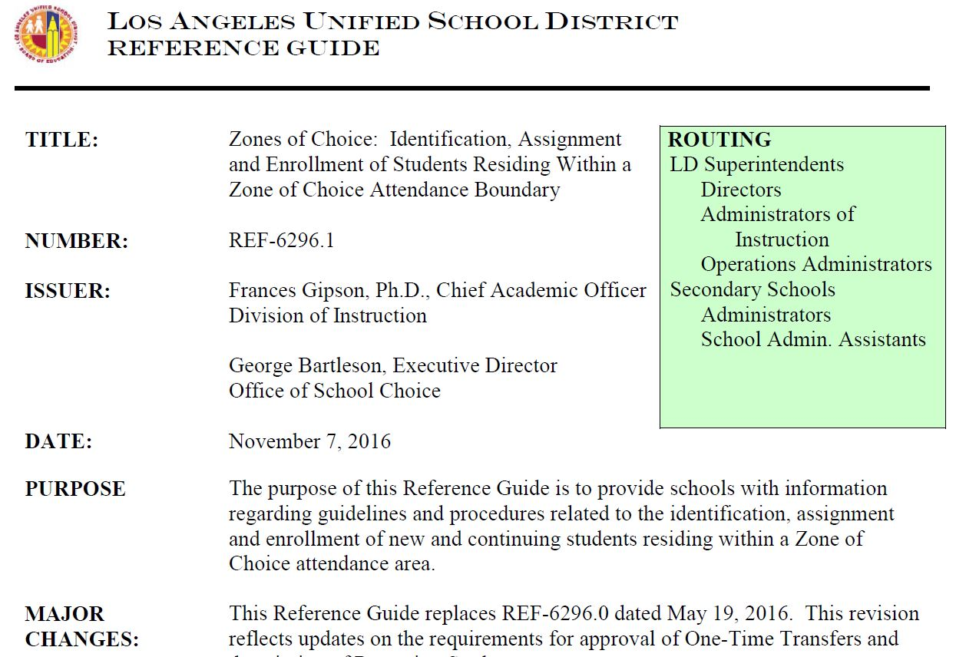
REFERENCE GUIDES
__________________________________________________________
ZOC Enrollment

Slide 25
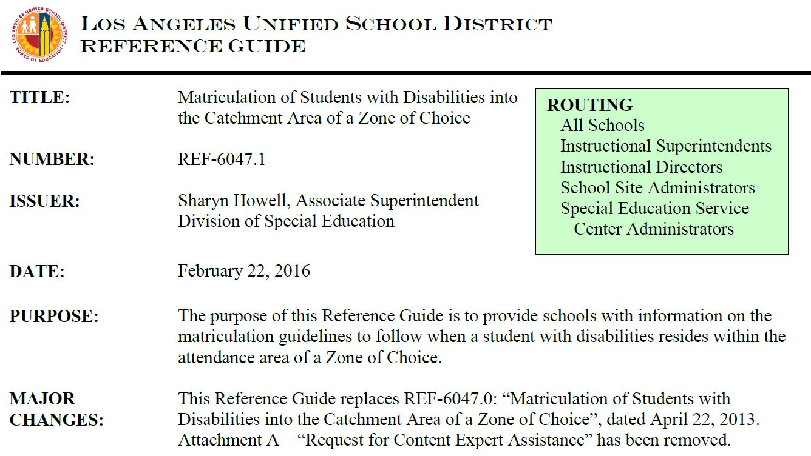
REFERENCE GUIDES
__________________________________________________________
ZOC Students with Disabilities
25

Slide 26
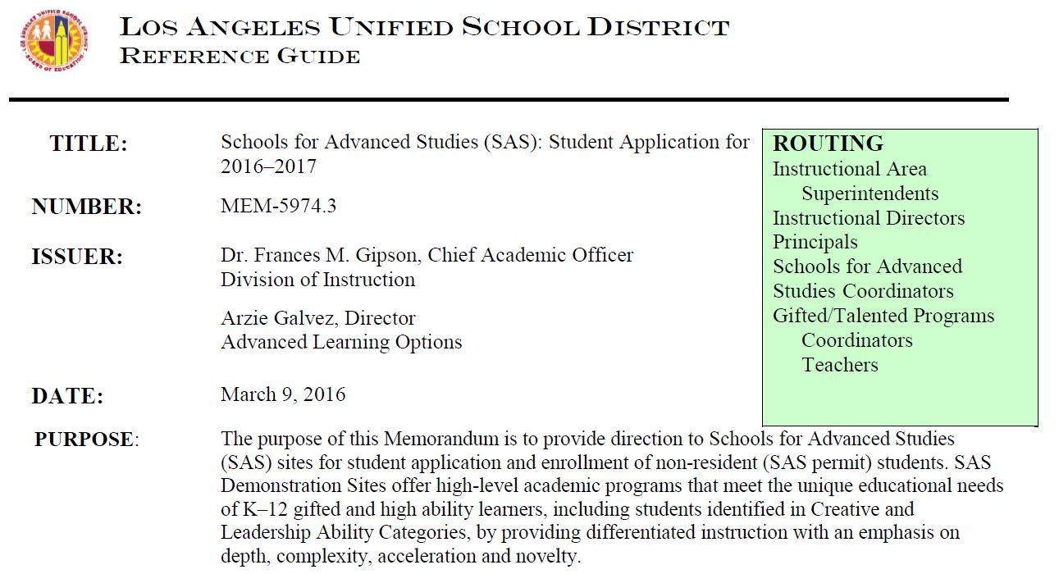
REFERENCE GUIDES
__________________________________________________________
ZOC Schools for Advanced Studies
26

Slide 27

ZOC TIMELINE
SEPTEMBER 2025
  ZOC Roadshows
  School action plans
  Articulation events
  School application changes
  Brochure and video
  ZOC informational flyer
  ZOC Binders & Banners NEW!
27

Slide 28

ZOC TIMELINE
OCTOBER 2025
  ZOC School Applications for SY 2026-2027 (October 1 – November 14, 2025)
  Parent Orientations
  Brochure and video posted on ZOC website
28

Slide 29

ZOC TIMELINE
NOVEMBER 2025
  ZOC online application closes November 14, 2025
  As of November 17th, paper applications can be submitted via email
29

Slide 30



ZOC TIMELINE
DECEMBER 2025
  Deadline for paper applications for Round #1
  Correction/Confirmation Letters
  E-CAST
JANUARY 2026
  Selection
FEBRUARY 2026
  Special Education Assignments for incoming 6th, 7th, and 9th graders are provided to SPED division
Notes:
Tools to publicize schools
January 2022 – List of students which schools retrieve from EZ-Access

Slide 31


ZOC TIMELINE
MARCH 2026
  Round #1 Placement Letters and Assignment Lists to Schools
  Assignment Appeals window March 9th – April 10th
  One-Time Transfer (OTT) application window March 9th – April 10th
APRIL 2026
  Round #2 Assignments (include appeals)
31

Slide 32


ZOC TIMELINE
MAY 2026
  OTT application process closes
  Round #3 Assignments Lists (including OTTs)
JUNE 2026
  Round 4 Assignments Lists
  High School brochures, videos, & application changes (SY 2027-2028)
32

Slide 33

CONTACT INFORMATION
__________________________________________________________
ZONES OF CHOICE
333 S. Beaudry Avenue
Los Angeles, CA 90017
Phone: (213) 241-0466
Fax: (213) 241-4108
ZOC@lausd.net
http://lausd.org/zoc
FACILITATORS
Angelica Cabrera, Facilitator
amc7753@lausd.net
(213) 241-0461
Rosalinda Vazquez, Facilitator
rosalinda.vazquez@lausd.net
(213) 241-0554
Sabrina Huizar, Facilitator
sabrina.huizar@lausd.net
(213) 241-0589
SUPPORT STAFF
Elias Higham, Administrative Aide
elias.higham@lausd.net
(213) 241-1928
33

Slide 34
Questions & Discussion
?
?
?
34

